Slide 1
UNIT-I

Slide 2
Introduction
What Is Information Security?
Information security in today’s enterprise is a “well-informed sense of assurance that the information risks and controls are in balance.”
–James Anderson

Slide 3
The Present
The Internet brings millions of computer networks into communication with each other—many of them unsecured
Ability to secure a computer’s data influenced by the security of every computer to which it is connected
Notes:
The Present
Today, the Internet has brought millions of unsecured computer networks into communication with each other.
Our ability to secure each computer’s stored information is now influenced by the security on each computer to which it is connected.

Slide 4
What Is Security?
The quality or state of being secure--to be free from danger.”
To be protected from adversaries.
A successful organization should have multiple layers of security in place:
  Physical security
  Personal security
  Operations security
  Communications security
  Network security
  Information security

Slide 5
What is Information Security?
The protection of information and its critical elements, including systems and hardware that use, store, and transmit that information.
Necessary tools: policy, awareness, training, education, technology
C.I.A. triangle was standard based on confidentiality, integrity, and availability.
C.I.A. triangle now expanded into list of critical characteristics of information.
Notes:
What Is Information Security?
Information security, therefore, is the protection of information and its critical elements, including the systems and hardware that use, store, and transmit that information.
But to protect the information and its related systems from danger, tools, such as policy, awareness, training, education, and technology are necessary.
The C.I.A. triangle has been considered the industry standard for computer security since the development of the mainframe. It was solely based on three characteristics that described the utility of information: confidentiality, integrity, and availability.
The C.I.A. triangle has expanded into a list of critical characteristics of information.

Slide 6
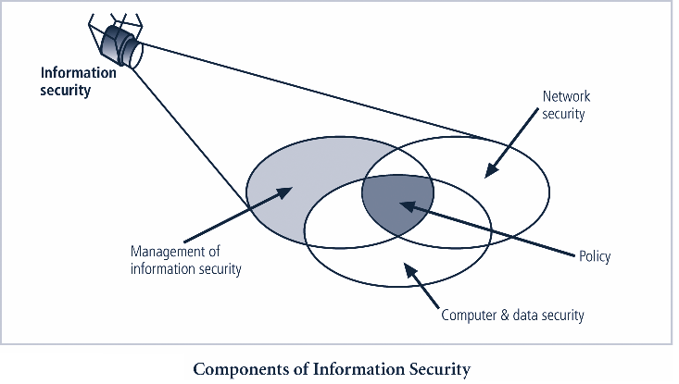

Slide 7
PRIMARY GOALS
CIA triangle known as security triad tells the primary goals of IS
Confidentiality
Making sure that those who should not see information
Integrity
Making sure that the information has not been changed from its original
Availability
Making sure that the information is available for use when you need it

Slide 8
Key information security concepts
Access
Asset
Attack
Control, safeguard or countermeasure
Exploit
Exposure
Loss
Protection profile or security posture
Risk
Subjects and objects
Threat
Threat agent
vulnerability

Slide 9
Information security policy, standards, and practices

Slide 10
Introduction
Creation of information security program includes:
  Creation of policies, standards, and practices, selection or creation of information security architecture and the development
  Use of a detailed information security blueprint creates plan for future success
  Creation of contingency planning consisting of incident response planning, disaster recovery planning, and business continuity plans
  Without policy, blueprints, and planning, organization is unable to meet information security needs of various communities of interest

Slide 11
Communities of interest must consider policies as basis for all information security efforts
Policies direct how issues should be addressed and technologies used
Security policies are least expensive controls to execute but most difficult to implement
Policy should never contradict law
Shaping policy is difficult
Never conflict with laws
Standup in court if challenged
Be properly administered through dissemination and documented acceptance

Slide 12
Policy
Plan or course of action
Convey instructions
Organizational laws
Dictate acceptable and unacceptable behavior

Slide 13
Define
  What is right
  What is wrong
  The appeal process
  What are the penalties for violating policy
Written to support the mission, vision and strategic plan of organization
For a policy to be effective, must be properly disseminated, read, understood and agreed to by all members of organization

Slide 14
Standards
Detail statements of what must be done to comply with policy
Types
  Informal – de facto standards
  Formal – de jure standards

Slide 15
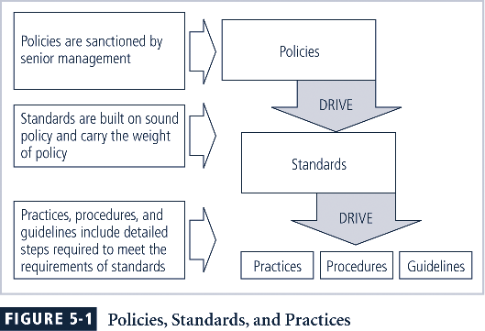

Slide 16
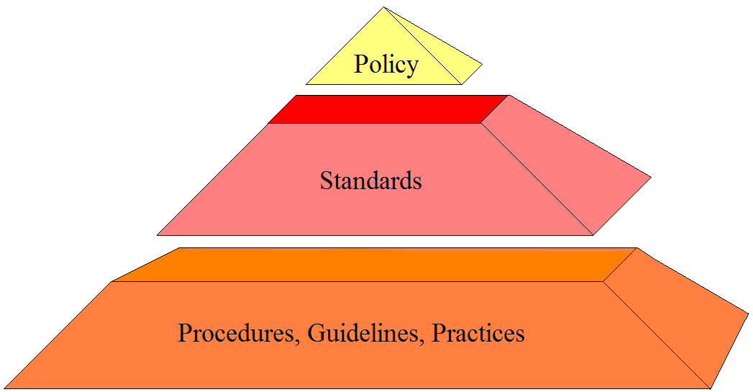
Security Policy
Access to network resource will be granted through a unique user ID and password
Passwords will be 8 characters long
Passwords should include one non-alpha and not found in dictionary
Notes:
A policy may have many standards associated.
A standard should have only one policy associated.
A standard may have many guidelines associated........

Slide 17
Policies
Security Policy – set of rules that protects and organization's assets.
Information security policy – set of rules that protects an organization’s information assets.

Slide 18
For a policy to be effective and thus legally enforceable, it must meet the following criteria:
Dissemination
Review
Comprehension
Compliance
Uniform enforcement
Three types
1. Enterprise information security policies
  2. General Issue-specific security policies
  3.System-specific security policies

Slide 19
Enterprise Information Security Policy (EISP)
General Information Security Document
Shapes the philosophy of security in IT
Executive-level document, usually drafted by or with CIO of the organization, 2-10 pages
According to the NIST Typically addresses compliance in two areas
  Ensure meeting requirements to establish program and the Responsibilities assigned therein to various organizational components
  Use of specified penalties and disciplinary action

Slide 20
EISP Elements
EISP documents should provide :
  An overview of corporate philosophy on security.
  Information about information security organization and information security roles.
  Responsibilities for security shared by all members of the organization.
  Responsibilities for security unique to each role within the organization.

Slide 21
Components of the EISP
Statement of Purpose:
  What the policy is for
Information Technology Security Elements:
  Defines information security
Need for Information Technology Security:
  justifies importance of information security in the organization
Information Security Responsibilities and Roles:
  Defines organizational structure
References Information Technology standards and guidelines

Slide 22
General Issue-Specific Security Policy (GISSP)
Every organization’s ISSP should:
  Address specific technology-based systems
  Require frequent updates
  Contain an issue statement on the organization’s position on an issue
GISSP topics could include:
  E-mail use,
  Internet and World Wide Web use,
  Specific minimum configurations of computers to defend against worms and viruses,
  Prohibitions against hacking or testing organization security controls,
  home use of company –owned computer equipment
  Use of personal equipment on company networks
  Use of telecommunication technologies (fax or phone)
  Use of photocopy equipment

Slide 23
Components of the GISSP
Statement of policy
  Scope and applicability
  Definition of technology addressed
  Responsibilities
Authorized Access and Usage of Equipment
  User access
  Fair and responsible use
  Protection of privacy
Management of Information Security, 3rd ed.
Notes:
23

Slide 24
Prohibited Usage of Equipment
  Disruptive use or misuse
  Criminal use
  Offensive or harassing materials
  Copyrighted, licensed or other intellectual property
  Other restrictions
Systems management
  Management of stored materials
  Employer monitoring
  Virus protection
  Physical security
  Encryption
Management of Information Security, 3rd ed.
Notes:
24

Slide 25
Violations of policy
  Procedures for reporting violations
  Penalties for violations
Policy review and modification
  Scheduled review of policy and procedures for modification
Limitations of liability
  Statements of liability or disclaimers
Management of Information Security, 3rd ed.
Notes:
25

Slide 26
Common approaches to implementing ISSP
Number of independent ISSP documents
Single comprehensive ISSP document
Modular ISSP document that unifies policy creation & administration
Recommended approach is modular policy, which provides a balance between issue orientation & policy management

Slide 27
Systems-Specific Policies (SysSPs)
They may often be created to function as standards or procedures to be used when configuring or maintaining systems
SysSPs can be separated into:
  Management guidance
  Technical specifications
  Combined in a single policy document

Slide 28
System-specific security policies (SysSPs) frequently do not look like other types of policy
  may function as standards or procedures to be used when configuring or maintaining systems
Management of Information Security, 3rd ed.
Notes:
28

Slide 29
Managerial Guidance SysSPs
Created by management to guide the implementation and configuration of technology
Applies to any technology that affects the confidentiality, integrity or availability of information, e.g. firewall configuration
Informs technologists of management intent.
Management of Information Security, 3rd ed.
Notes:
29

Slide 30
Technical Specifications SysSPs
System administrators’ directions on implementing managerial policy.
Each type of equipment has its own type of policies.
Two general methods of implementing such technical controls:
  1. Access control lists
  2. Configuration rules

